Slide 1
Paper Review on: Text Classification with Negative Supervision
Slide prepared by:
Priata Nowshin – 20141035
Shahriar Rumi Dipto – 20141036
Galib Abdun Noor - 20141037
https://www.aclweb.org/anthology/2020.acl-main.33/

Slide 2
Introduction
Problem we face to perform various text classification tasks:
Classifier affected by differences between semantic similarity of texts and labelling standards.
To address the problem :
Simple multitask learning model that used negative supervision.
single and multi-label classifications,
sentence and document classifications
and classifications in three different languages.
Sentences labels BERT
A cold is a disease. -- COLD
I caught a cold. Cold COLD

Slide 3
Architecture of the models
Main Task
Auxiliary Task
A cold is a
disease
I’m coughing
Two models :
First model learns an ordinary classification task.
Second model encourages representations with different class labels to be distinct
I caught a cold
Encoder
Classifier
Discriminator
Cold

Slide 4
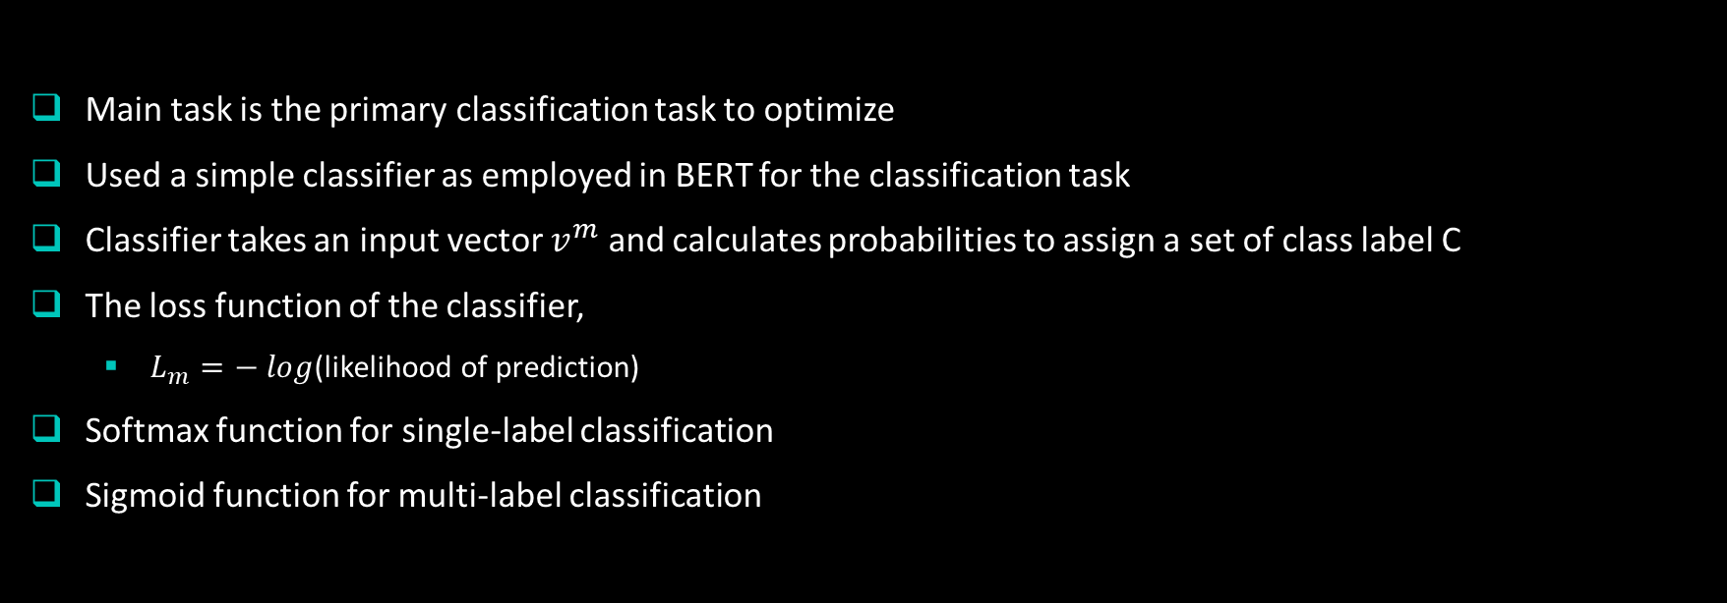
Classifier model for the main task
Main task is the primary classification task to optimize
Used a simple classifier as employed in BERT for the classification task
Classifier takes an input vector $v^{m}$ and calculates probabilities to assign a set of class label C
The loss function of the classifier,
$L_{m}=− log$(likelihood of prediction)
Softmax function for single-label classification
Sigmoid function for multi-label classification

Slide 5
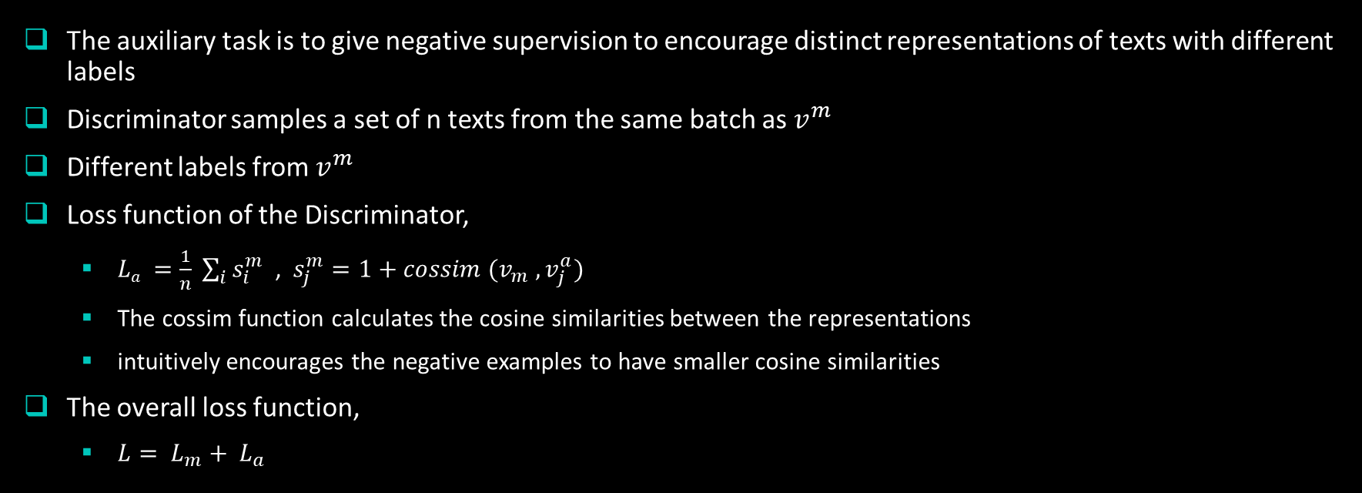
Discriminator model for the auxiliary task
The auxiliary task is to give negative supervision to encourage distinct representations of texts with different labels
Discriminator samples a set of n texts from the same batch as $v^{m}$
Different labels from $v^{m}$
Loss function of the Discriminator,
$La =$ $\frac{1}{n} \sum_{i}{s_{i}^{m}}$ , $s_{j}^{m}=1+cossim (v_{m} , v_{j}^{a})$
The cossim function calculates the cosine similarities between the representations
intuitively encourages the negative examples to have smaller cosine similarities
The overall loss function,
$L= L_{m}+ L_{a}$

Slide 6
EXPERIMENT
Single-Label Classification:
For this classification MR, CR, SST-5, TREC and SUBJ datasets are used. The evaluation metric for these single-label classification tasks is accuracy.
Multi-Label Classification:
For this classification MedWeb and arXiv datasets are used. The evaluation metric for multi-label classification is Exact-Match.
Here BERT and a Hierarchical Attention Network (HAN) are employed as a text encoder for generating sentence and document representation, respectively. Fine-tuned BERT-base models were used for conducting sentence classification and the original HAN for document classification.
Authors evaluated two variations of their model. The first purely gives negative supervision and the second uses margin-based loss as a function La with a positive example as well as negative examples.

Slide 7
CONTRIBUTION AND FURTHER WORK
Contribution:
The results indicate that their models of AM and AAN consistently outperform the strong Baselines on both single-label and multi-label classifications, sentence and document classifications, and classifications in different languages compared to the previous state-of-the-art methods. Most notably, their models are effective even for multi-label classification, which is more challenging than its single-label counterpart. Unlike AM and AAN, ACE degraded the performance of the Baseline except for the MedWeb Japanese task. This result shows that simple multitask learning is ineffective and that their design using negative supervision is crucial.
Further work:
Future work should focus on the semantic relations among class labels in the auxiliary task. Moreover, they will adapt their model to text generation tasks. They expect that their model will encourage a generation model to generate texts with different labels, such as styles, have distinct representations, which will result in class specific expressions.

